Slide 1


BUSI 622 MANAGING DIGITAL BUSINESSES AND MARKETS
Android: The Wind that Changed Smartphoning
SUBMITTED BY :
SADIA PARVEZ
RAHUL RAJ SINGH
SHRUTI GUPTA
DIVYA CHHABRA
ASHISH VERMA

Slide 2





Introduction
“Disruptions start with a thought that something needs to be better.”
- Kylene Beers and Robert E. Probst

Slide 3
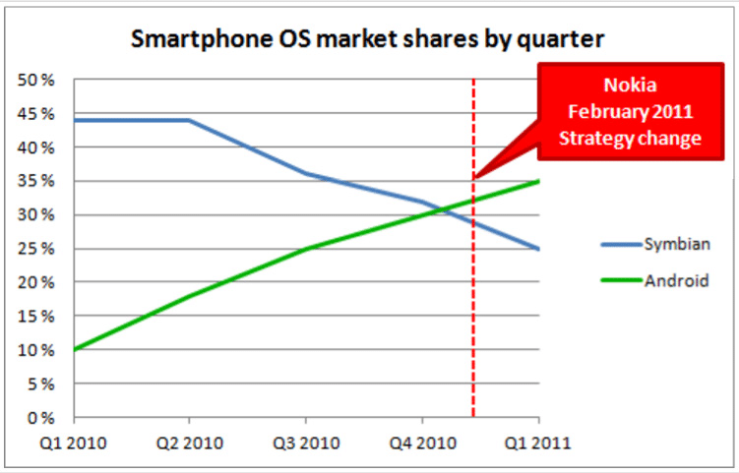
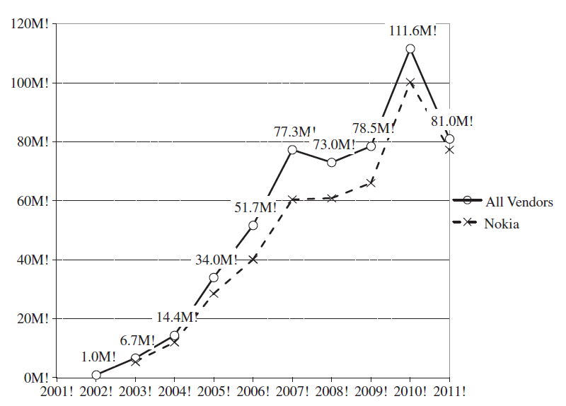
Global Unit Sales of Symbian OS Phones (Millions)
How Android KILLED Symbian OS?

Slide 4
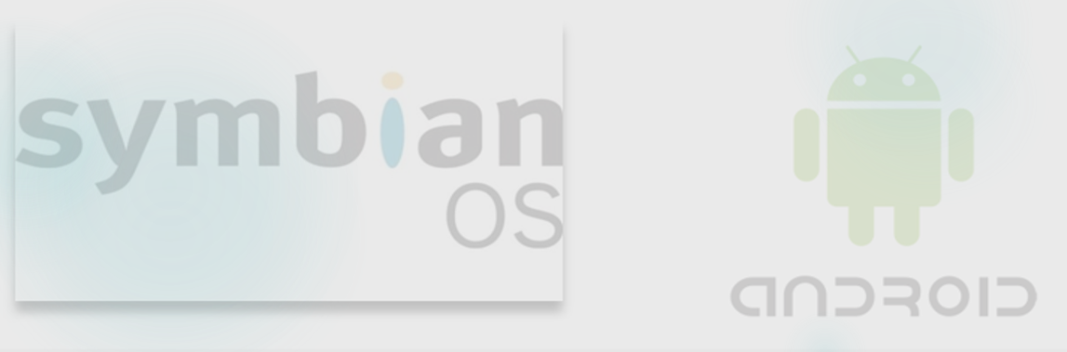
Platform Design
Symbian
Android
Launched in 1998
Sponsor: Psion, Nokia, Ericsson and Motorola
Provider: Psion, Nokia, Ericsson and Motorola
Launched in 2003
Sponsor: Andy Rubin
Provider: Any external partner
Always open platform
Initially closed platform. Later, changed to open platform

Slide 5
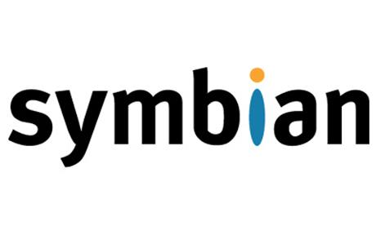

Creative Destruction
Symbian
Complex design of OS
Obstinate developer bureaucracy
Highly priced IDEs and SDKs
Fragmentation
Initially designed for keypad devices
Slow processors
Lack of variety of applications

Slide 6
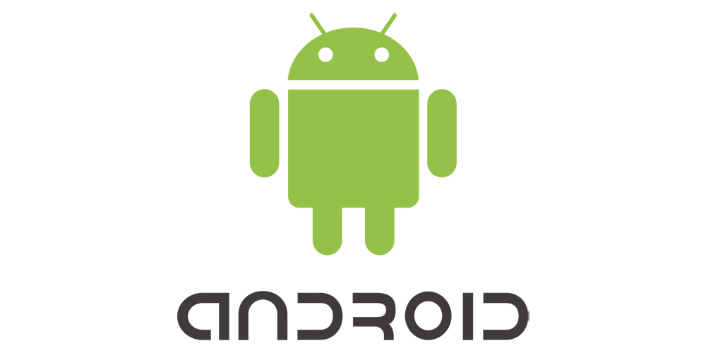

Creative Destruction
Android
Simpler design
Centralized infrastructure to create and obtain third party apps
Multitasking and graphics aimed to meet future customer demands
Touch support since its inception
Fast processors hence superior performance
Abundance of exclusive applications

Slide 7

Switching and Multi-Homing Costs
Symbian
Android
Android
Licensing fee
Fragmented app/ecosystem community - porting apps across platforms was difficult
Multiple UIs, which were not compatible
Key differences compared to PC archetype
Companies that deal with Android never had to pay a license fee to the company for using the platform.
Single storefront, easy to buy apps
Android has standard UI from start
Android emulated PC capabilities

Slide 8
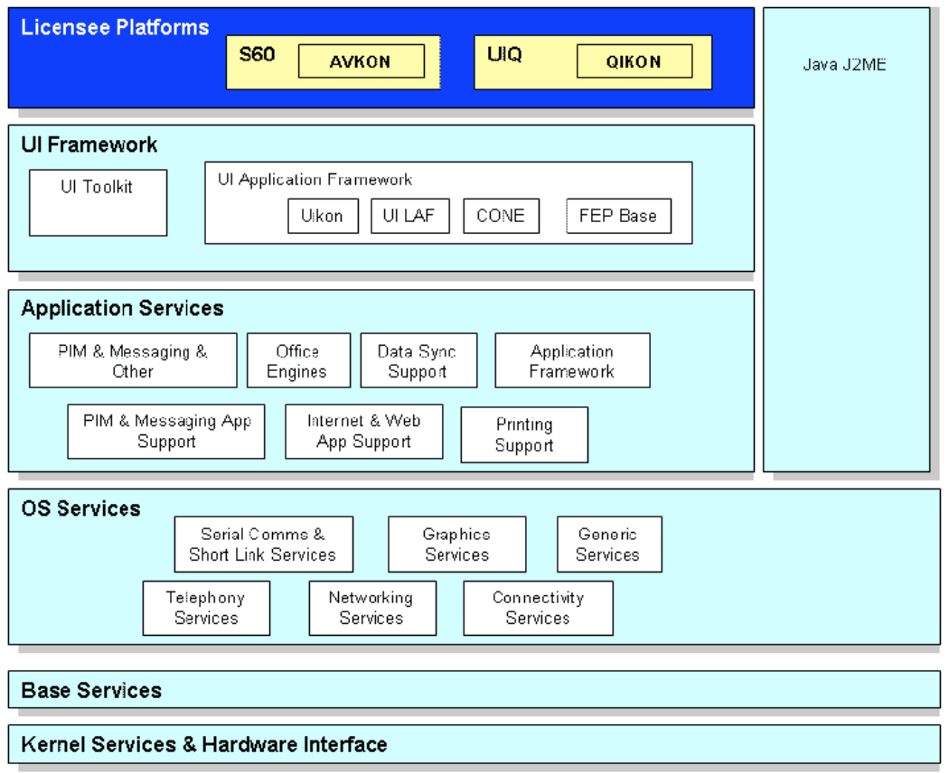
Switching and Multi-Homing Costs
Symbian
Android
Android
No direct relationship with customers – software upgrades not available with old phones
UIQ interface – stylus based input method
Browser compatibility - website compatibility comparable to a desktop browser
Upgrades were easily available
Touch based
Android used WebKit, far before Symbian launched Opera
The structure of Symbian OS

Slide 9

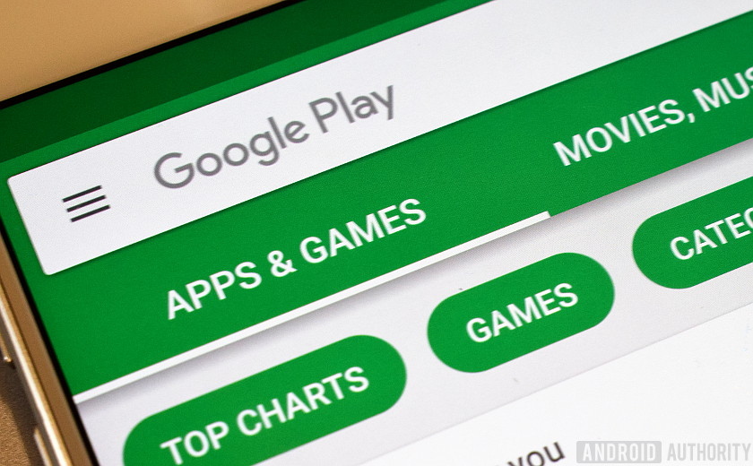
Android as a multi sided Platform
Side A
Side B
Notes:
Hello I am Divya Chhabra and I will now elaborate on how Android is a multi-sided platform and how network effects helped it grow as a platform.
Android has 2 sides namely users and developers, they need both of them for the platform to grow. To overcome the chicken and egg problem here, Android came up with various strategies
Tie up with mobile networks, they offered subsidized bundles
Tie up with brands, wherein the brands could display their ads on various apps in android
Opened up the platform to app developers and let them monetize their apps and offeredlarge user base
It gave the users access to a revolution in the mobile phone market – smart phones
With the brand name google attached to it and being an end to end product android attracted eyeballs and spiked consumer intrest

Slide 10
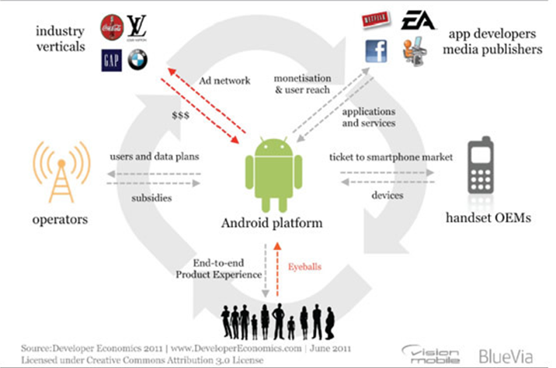
Network Effects
Notes:
Hello I am Divya Chhabra and I will now elaborate on how Android is a multi-sided platform and how network effects helped it grow as a platform.
Android has 2 sides namely users and developers, they need both of them for the platform to grow. To overcome the chicken and egg problem here, Android came up with various strategies
Tie up with mobile networks, they offered subsidized bundles
Tie up with brands, wherein the brands could display their ads on various apps in android
Opened up the platform to app developers and let them monetize their apps and offeredlarge user base
It gave the users access to a revolution in the mobile phone market – smart phones
With the brand name google attached to it and being an end to end product android attracted eyeballs and spiked consumer intrest

Slide 11
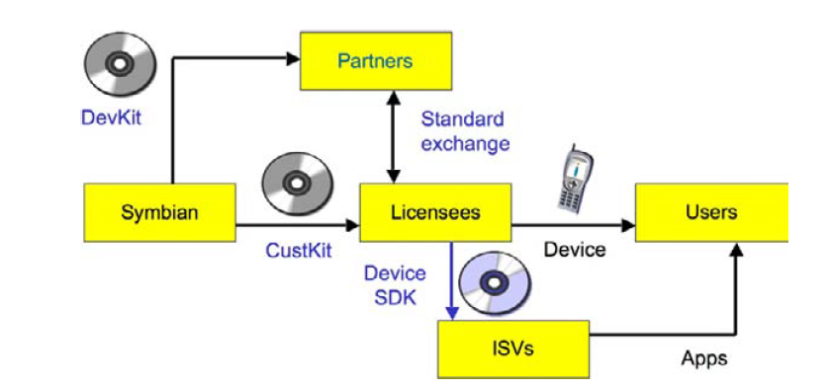
Value Creation
Symbian
Android
End Users
App Developers
Content
API, Dev Tools, social plugins
Applications
Android
~$8 Billion
X 4 Times =
~$32 Billion

Slide 12

Conclusion
“Those who disrupt their industries change consumer behavior, alter economics, and transform lives.”
- Heather Simmons

Slide 13
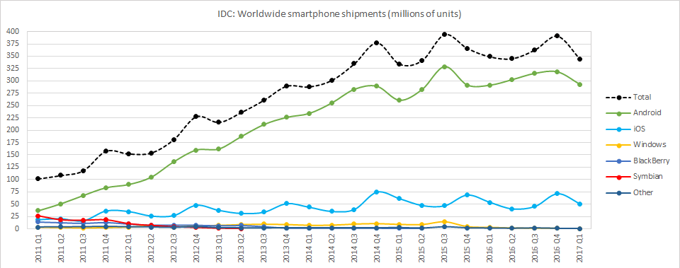
The Future
Strong and positive network effects
High multi-homing costs
Low need for differentiated features
Current Market Share of Android: ~85%

Slide 14
References
Web links
Android
http://citeseerx.ist.psu.edu/viewdoc/download?doi=10.1.1.721.9498&rep=rep1&type=pdf
http://disruptivewireless.blogspot.com/2008/07/nokia-series-40-6th-edition.html
https://www.theverge.com/2016/9/30/13119924/blackberry-failure-success
https://www.zdnet.com/article/android-before-android-the-long-strange-history-of-symbian-and-why-it-matters-for-nokias-future/
https://www.gartner.com/en/newsroom/press-releases/2017-02-15-gartner-says-worldwide-sales-of-smartphones-grew-7-percent-in-the-fourth-quarter-of-2016
https://www.businessinsider.com/android-iphone-market-share-2011-4

Slide 15
References
Web links
Android
https://en.wikipedia.org/wiki/Symbian
http://guardianlv.com/2014/03/android-vs-symbian/
https://mobilityarena.com/evolution-android-os/
https://socialwebbiz.wordpress.com/tag/multi-sided-markets/
https://www.marketing91.com/marketing-strategy-android/
https://www.statista.com/statistics/266219/global-smartphone-sales-since-1st-quarter-2009-by-operating-system/

